Slide 1
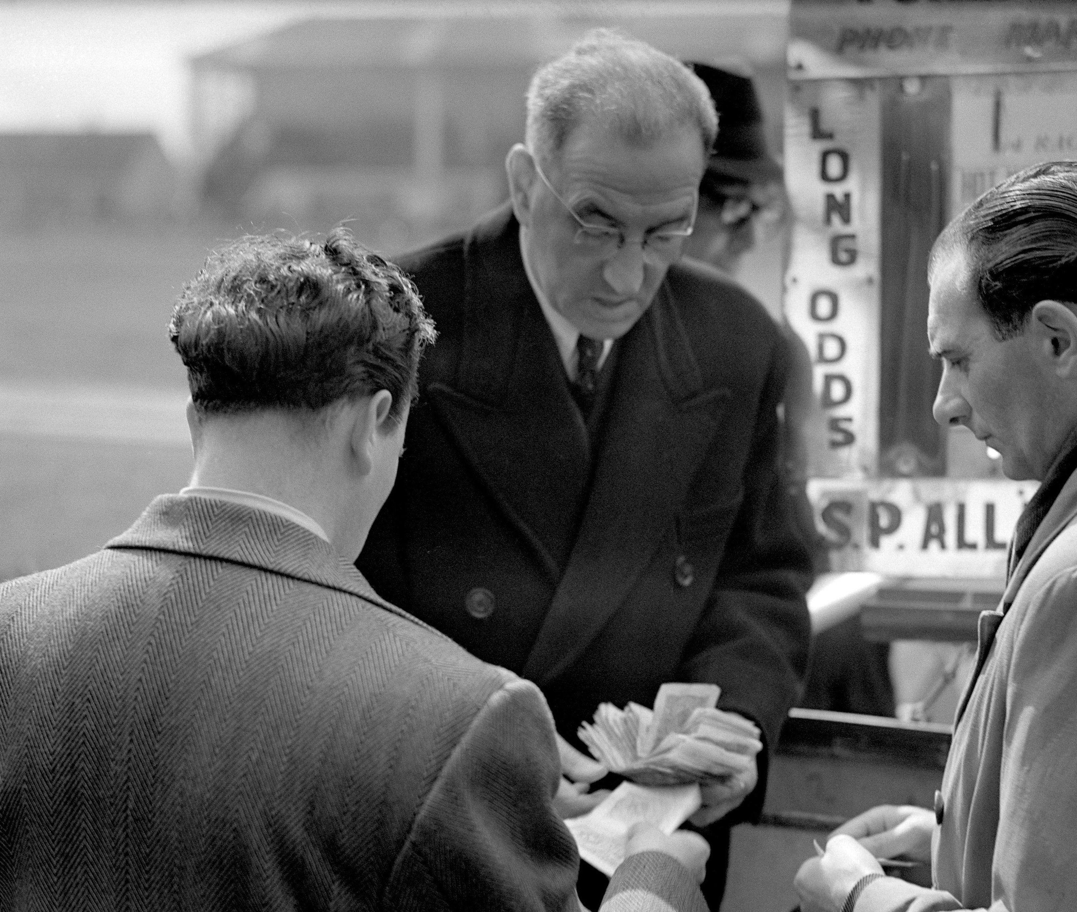
Decentralized
Betting
A EMURGO CDP PLUTUS PROJECT

Slide 2
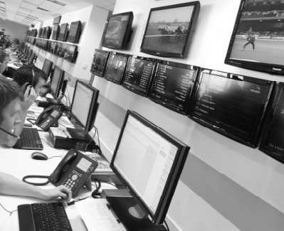
Centralized
Platforms
Bookmakers / Statisticians by the hundreds
Traditional betting at scale is managed by large centralized firms. The goal of these firm is, at the end of the day to make money, with almost zero risk. For that they hire a large amount of mathematicians & statisticians as bookmakers. Their role is to simply make the Expected Value on a large amount of bet superior to zero at all cost and if possible maximize it.
∑E(X) > 0
Max ∑E(X)
The classical individual, when placing a bet, is competing against all these professionals that have only one goal of reducing the risk across, individual bets, all bets from an individual & all the bets of all individuals on a singular events. On a long enough time frame, the individual as almost no chance of making money, no matter how good he is

Slide 3
Security & Privacy
Fairness
Thanks to the smart contract, the bet & funds are totally secure, transparent & recorded. It not only reduces the risks of Fraud, but also increase privacy (no KYC) & prevent censorship when you start winning too much.
A decentralized Betting platform allow each individual to compete against each other and not against conglomerates. A user seems to have an unfair advantage? You can chose an other betting partner
Advantages
Decentralized Betting offer all the advantages of a secured betting platform & all the opportunities of a peer to peer bet. All thanks to the Cardano Blockchain
Flexibility
Accessibility
With Decentralized Betting and the Peer to Peer aspect that comes from it, the conditions of the bets are totally flexible to suit your desire. After creating your perfect bet, all you need is someone to accept it
No matter where you are, who you are and your financial situation, you are able to participate in betting with everyone with a position that fits your need

Slide 4
How does it work
1. Connect to the application & connect your wallet
3.a. Browse the existing bets & Accept one of them
Connect Wallet
Jaco –
Odds: 3,2 – Lyon Win
Demmy –
Odds: 1,5 – Paris Win
Roberto –
Odds: 1,3 – Paris Win
Accept
2. Browse the matchs & select the one you would like to bet on
Accept
Accept
Paris –
Lyon
Real Madrid –
Barcelona
Bayern Munich –
Francfort
Manchester Utd –
Liverpool FC
Sign the Transaction & Enjoy the match
BET
BET
3.b. Create your own bet with your own odds
BET
Lorys –
Odds: 4,5 – Lyon Win
BET
Accept

Slide 5
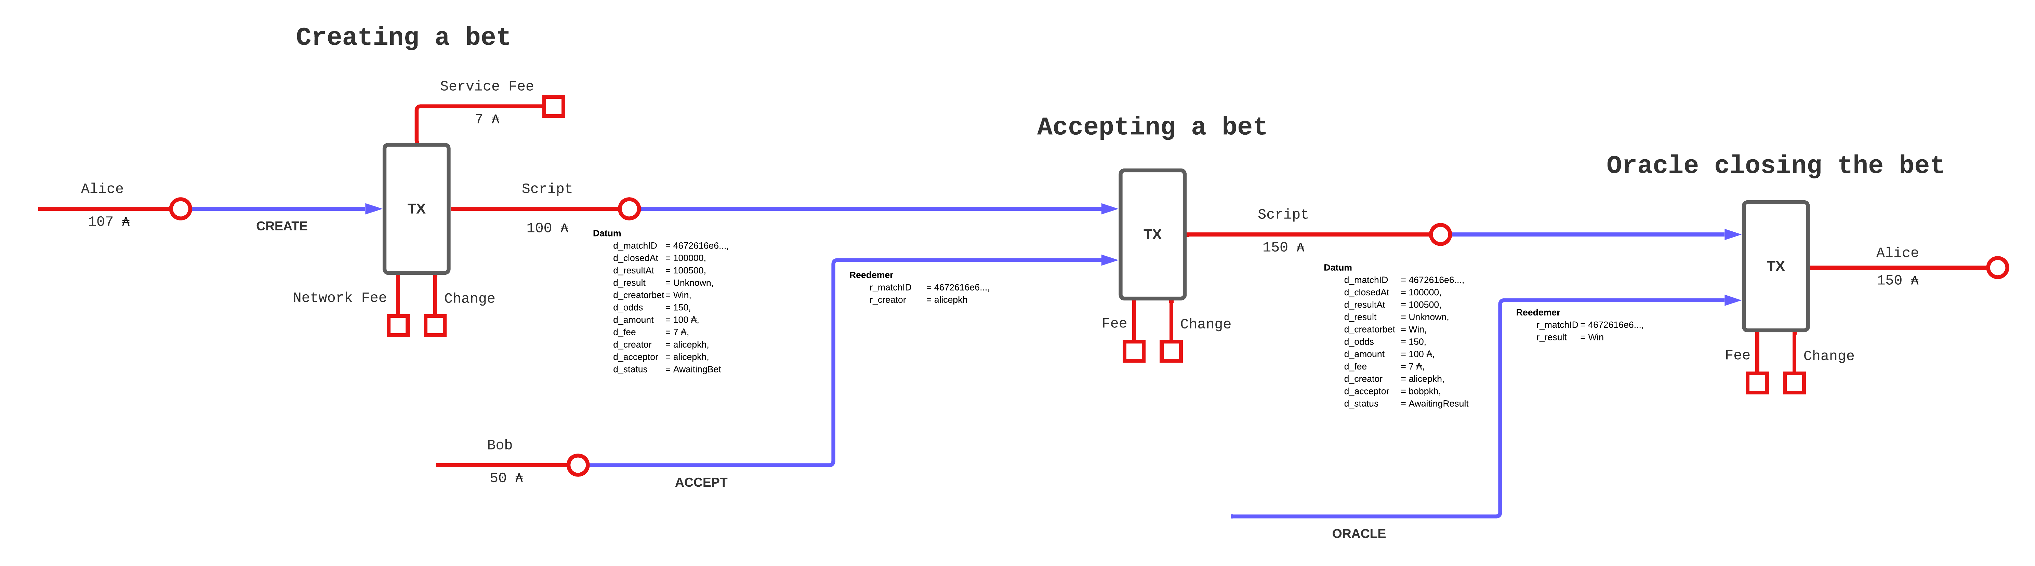
Utxo Model

